Slide 1
AI-powered income protection for delivery partners
TEAM MEMBERS:
P.SHADHAI JOSEPH – 2300032260
P.VIGNESH - 2300032549
G.V.KARTHIK - 2300033145
G.SARATH BABU - 2300033633

Slide 2
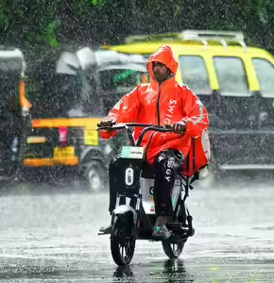
The Problem
Delivery partners lose 20–30% of weekly income
Caused by rain, heat, pollution, outages
No short-term income protection exists

Slide 3
Our Solution:
GigShield AI provides:
Weekly micro-insurance model
AI based risk scoring & premium calculation
Automatic parametric triggers
Zero touch claim processing
Instant payout simulation

Slide 4
Workers Flow
1. User activates weekly policy 2. System monitors weather conditions 3. Disruption is detected 4. Claim is verified automatically 5. Payout is processed instantly

Slide 5

GPS-based systems are easily spoofed
Our Solution: Multi-Signal Claim Trust Engine
We verify using,
Movement patterns
Delivery activity
Device integrity
Network/IP signals
Environmental consistency

Slide 6
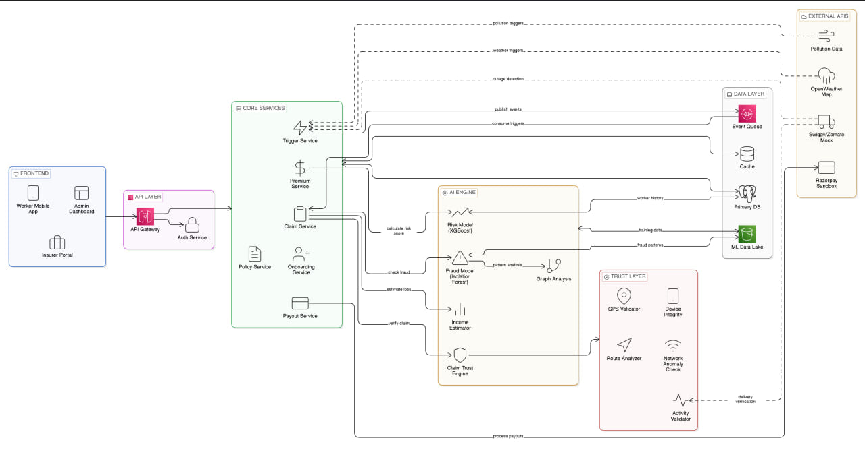
SYSTEM ARCHITECTUE
System Layers:
Frontend:
Worker mobile app
Admin & Provider dashboards
Backend:
Policy service
Trigger engine
Fraud detection
Payout engine
AI Models:
Risk Prediction (XGBoost)
Fraud Detection (Isolation Forest)
Income Loss Estimation
Integrations:
Weather API
Platform API (mock)
Payment gateway (Razorpay)

Slide 7
GigShield AI Securing Income. Preventing Fraud. Empowering Gig Workers.
Faster payouts for workers
Reduced fraud losses
Increased trust in gig platforms
Scalable insurance model
Business Model:
5–10% platform commission
B2B partnerships with delivery platforms
THANK YOU

